Slide 1
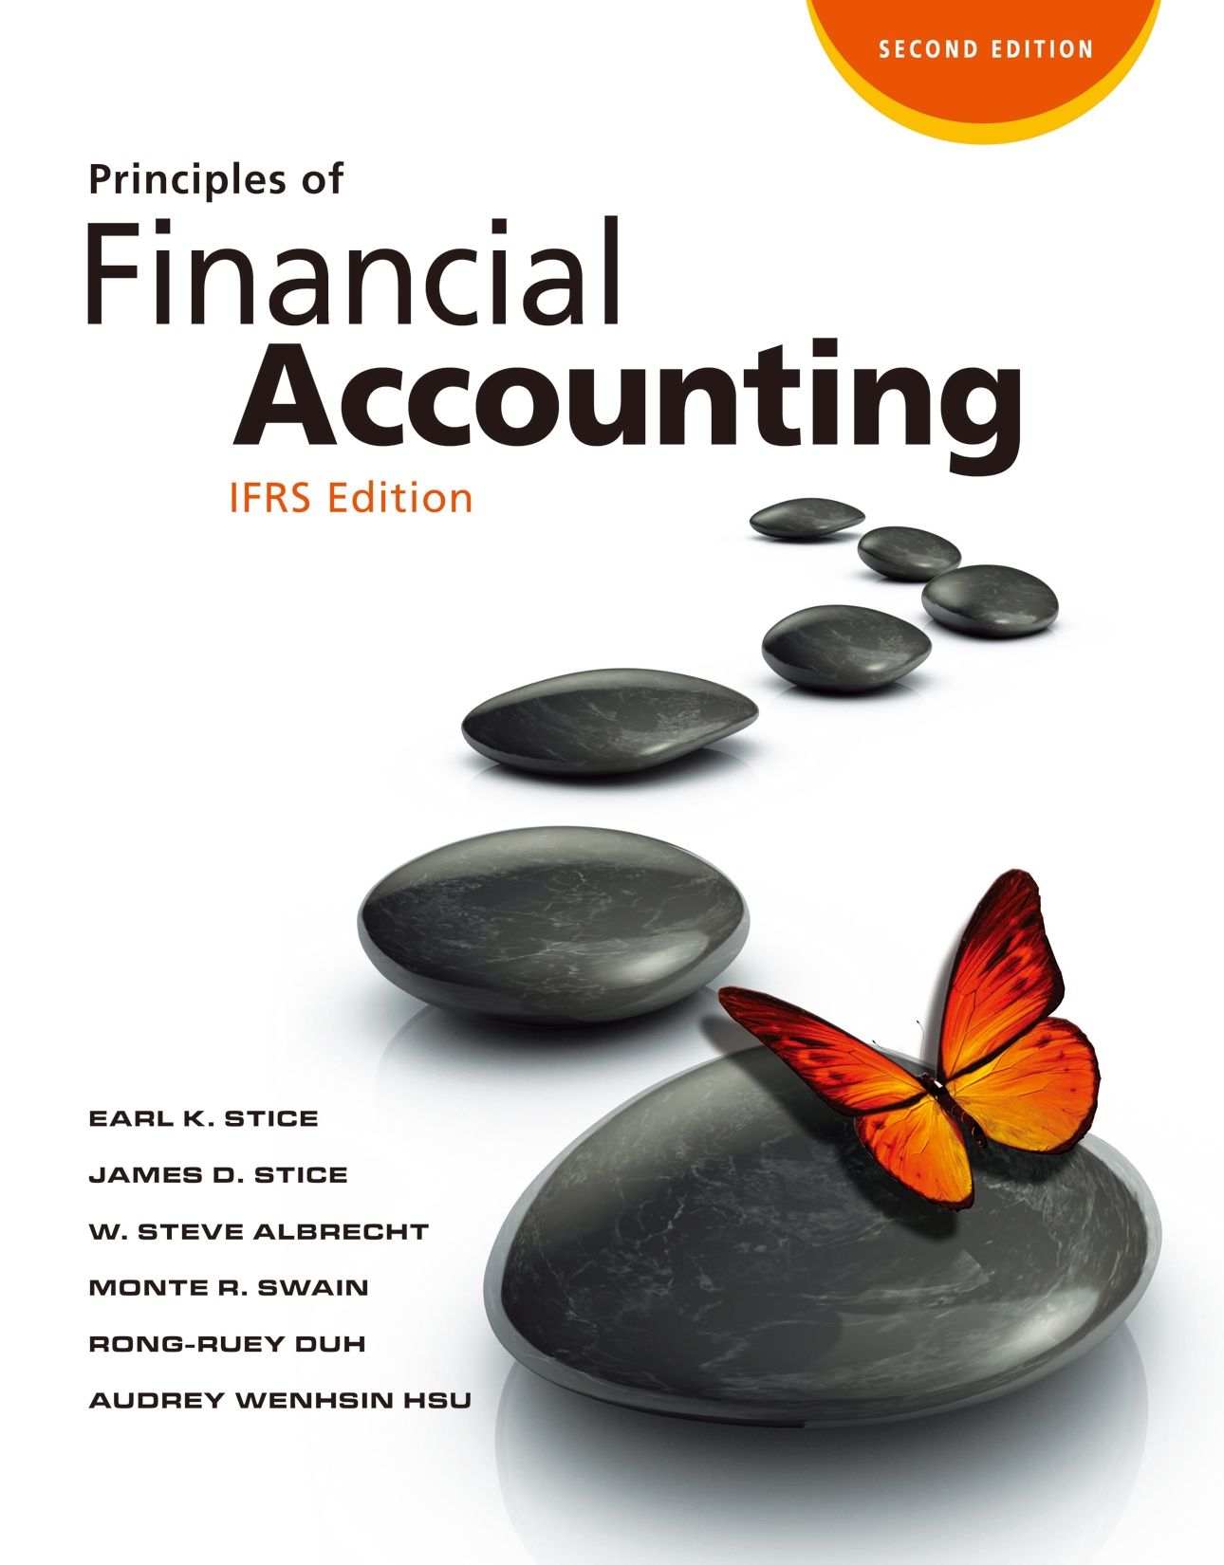

Slide 2
Internal Controls and Cash

Slide 3
Internal Controls and Cash

Slide 4
Types of Problems
The Types of Problems That Can Occur
LO1
Errors
Unintentional mistakes.
Immediately corrected when detected.
Disagreements
Different conclusions based on the same set of facts.
Frauds
Intentional errors.

Slide 5
Types of Errors in the Reporting Process
LO1
Errors in Transactions and Journal Entries
The document was lost and was not entered into the accounting records.
The amount entered into the accounting records was incorrect.
The accounts involved were incorrectly identified.
Errors in Accounts and Ledgers
Posting to the wrong account.
Posting the wrong amount.

Slide 6
Internal Control Structure
Safeguards Designed to Minimize Problems
LO2
Policies and procedures established to provide management with reasonable assurance that the objectives of an entity will be achieved.
The responsibility for establishing and maintaining the internal control structure belongs to a company’s management.

Slide 7
Internal Control Structure
LO2
Five Concerns When Designing Internal Controls:
To provide accurate accounting records and financial statements containing reliable data for business decisions.
To safeguard assets and records.
To effectively and efficiently run their operations, without duplication of effort or waste.
To follow management policies.
To comply with the laws and regulations (e.g., Foreign Corrupt Practices and Sarbanes-Oxley acts in the U.S.), which require companies to maintain proper record-keeping systems and controls.

Slide 8
Internal Control Structure
LO2
Sarbanes-Oxley Act
A law passed by the U.S. Congress in 2002.
Gives the SEC significant oversight responsibility and control over companies issuing financial statements and their external auditors.

Slide 9
Internal Control Structure
LO2
Sarbanes-Oxley Act
Requires every company’s annual report contain an “internal control report,” which must
State the responsibility of management for establishing and maintaining an adequate internal control structure and procedures for financial reporting
Contain an assessment of the effectiveness of the internal control structure by management
Contain an independent assessment of the reliability of internal controls by the independent auditor

Slide 10
Internal Control
LO2
Five Basic Categories of Internal Control Structure
The control environment
Risk Assessment
Control activities
Information and communication
Monitoring

Slide 11
The Control Environment
LO2
The actions, policies, and procedures that reflect the overall attitudes of top management about control and its importance to the company.
Organizational structure: Lines of authority and responsibility making companies easier to conceal dishonest transaction.
Independent oversight by establishing an audit committee.

Slide 12
Control Activities (Procedures)
LO2
Policies and procedures used by management to meet their objectives.
Control activities fall into five categories：
Segregation of duties
Proper procedures for authorization
Physical control over assets and records
Adequate documents and records
Independent checks on performance
Preventative Controls
Detective Controls

Slide 13
Control Activities (Procedures)
LO2
Adequate Segregation of Duties
No one department or individual should be responsible for handling all or conflicting phases of a transaction
Three functions should be performed by separate departments or by different people:
Authorization
Record keeping
Custody of assets

Slide 14
The Role of Auditors in the Accounting Process
The Role of Auditors in the Accounting Process
LO3
Auditors provide management (and stockholders) with some assurance that
The internal control system is functioning properly.
The financial statements fairly represent the financial performance of the firm.

Slide 15
Types of Auditors
LO3
Internal Auditors
An independent group of experts in controls, accounting, and operations
Works of Internal Auditors
Monitor operating results and financial records
Evaluate internal controls
Assist with increasing the efficiency and effectiveness of operations
Make sure that laws and regulations are complied
Detect fraud

Slide 16
Types of Auditors
LO3
External Auditors
Independent CPAs examine an organization’s financial statements to determine if they are prepared and presented in accordance with GAAP and are free from material (significant) misstatement.
Issue opinions about the reliability of an organization’s internal controls.

Slide 17
Types of Auditors
LO3
External Auditors
CPAs are required by generally accepted auditing standards (GAAS) to provide reasonable assurance that significant fraud or misstatement is not present in financial statements.
It is not possible for auditors to guarantee that financial statements are “correct.”
Can only provide reasonable assurance that financial statements are “presented fairly.”

Slide 18
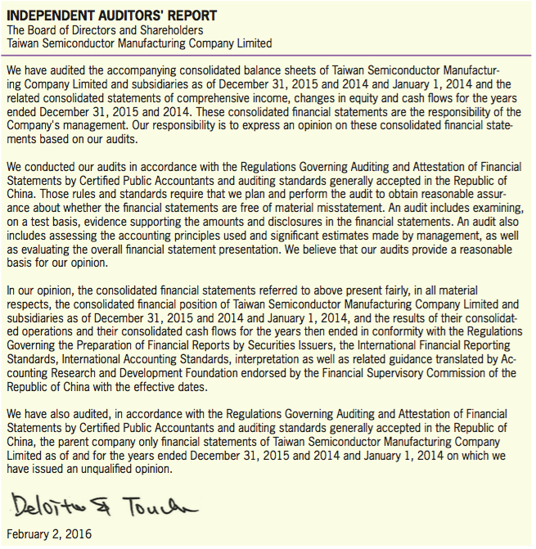
Types of Auditors
LO3
Independent Auditors’ Report
Exhibit 5.3

Slide 19
Types of Auditors
LO3
Exhibit 5.3

Slide 20
Major Activities of a Business
Cash and Internal Control
LO4
Operating Activities
Selling products or services
Buying inventory for resale
Incurring and paying for necessary expenses
Always be associated with the primary purpose of a business.

Slide 21
Major Activities of a Business
LO4
Investing Activities
Purchase of assets for use in the business.
Assets purchased includes property, plant, and equipment, and financial assets.
Occur less frequently and the amounts involved in each transaction are usually quite large.

Slide 22
Major Activities of a Business
LO4
Financial Activities
Raising money to finance a business by means other than operations.
Money can be borrowed from creditors (debt financing).
Money can be raised by selling stock or ownership interests in the business to investors (equity financing).

Slide 23
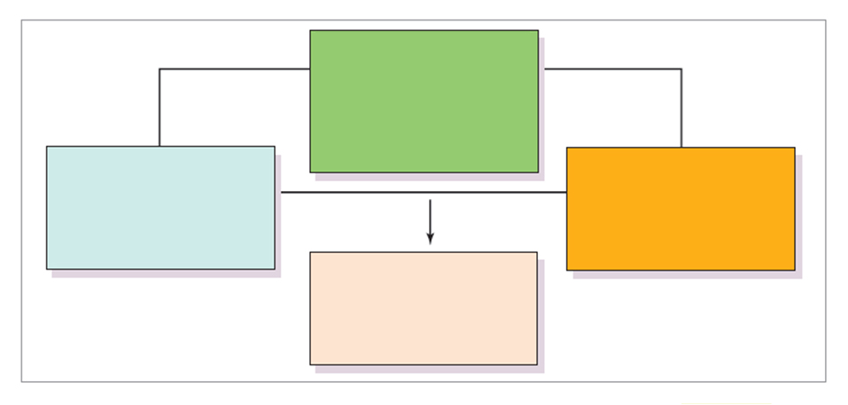
Major Activities of a Business
LO4
Operating Activities
1. Sell products and services (Ch. 6)
2. Acquire inventory for resale
(Ch. 5 and Ch. 7)
3. Acquire and pay for other operating
items and report profitability (Ch. 8)
Financing Activities
Investing Activities
1. Debt financing (Ch. 10)
2. Equity financing (Ch. 11)
1. Buying and selling property, plant,
and equipment (Ch. 9)
2. Buying and selling stocks and
bonds of other companies (Ch. 12)
Financial Statement
Summary and Review
1. Statement of cash flows (Ch. 13)
2. Financial statements analysis
(Ch. 14)
Exhibit 5.5

Slide 24
Cash and Business Activities
LO4
Operating Activities
Selling products or providing services will bring cash to the company.
Purchasing inventory for resale and incurring salary expenses, rent expenses will cause cash outflows.
Even credit sales or credit purchases will cause cash flows because of collecting cash or paying cash subsequently.

Slide 25
Cash and Business Activities
LO4
Investing Activities
Purchasing property, plant and equipment for the use in operation will use cash.
Disposal of property, plant and equipment will cause cash inflows.
Financing Activities
Borrowing money from creditors or raising money from investors will bring money in.
Repayment of debts or distributing cash dividends to shareholders will cause cash outflows.

Slide 26
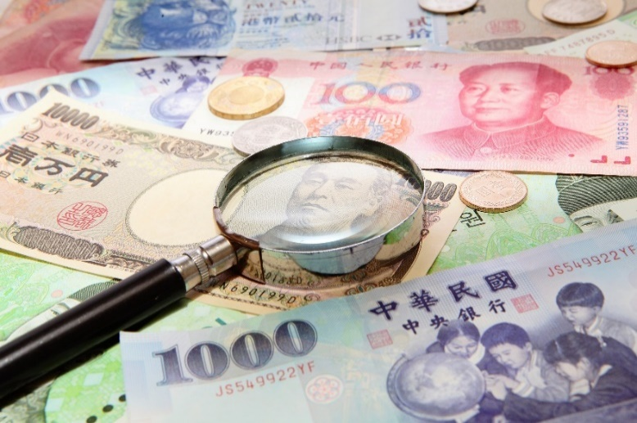
Internal Control of Cash
LO4
Definition of Cash
Includes coins, currency, money orders and checks,
And money on deposit with banks or savings institutions that are available for use to satisfy the company’s obligations.

Slide 27
Internal Control of Cash
LO4
Cash Control Procedures
Separating duties in handling of cash and accounting for cash.
Cash receipts are deposited in banks.
Except for small-amount payments, all payments are made with prenumbered checks.
Prepare a bank reconciliation periodically.

Slide 28
Payment by Checks
Accounting for Cash Payments
LO5
Payment for Purchasing Inventory
Hot Pot Bakery purchased inventory with cash NT$2,000 and NT$3,000 on account.
Hot Pot Bakery paid NT$3,000 one month later.
Inventory
5,000
Cash
2,000
Accounts Payable
3,000
To record cash and credit purchases of inventory.
Accounts Payable
3,000
Cash
3,000
To record payment for previous credit purchase.

Slide 29
Payment by Checks
LO5
Purchases Discounts
A seller may offer a discount to encourage its customer to pay earlier.
“2/10, n/30” means if the customer paid within 10 days, the customer will get 2% discount, and the amount is due in 30 days without any discount.
Suppose Hot Pot Bakery purchased some flour for NT$1,000 on March 1, 2017:
Mar. 1, 2017
Inventory
1,000
Accounts Payable
1,000
To record credit purchase of inventory.

Slide 30
Payment by Checks
LO5
Purchases Discounts
These purchases discounts can be seen as savings or interests during the period.
If Hot Pot Bakery paid on March 6, 2017 to earn the discount, then Hot Pot Bakery can save NT$20.
NT$1,000 x 2% = NT$20
Mar. 6, 2017
Accounts Payable
1,000
Cash
980
Inventory
20
To record the earned discount and payment for inventory.

Slide 31
Payment by Checks
LO5
Purchases Discounts
If Hot Pot Bakery didn’t pay within 10 days, it has to pay NT$20 more because of the interests of 20 days, which means that the interest rate for the 20 days is about 37%.
NT$980 x 37% x 20/360 = NT$20
Hot Pot Bakery missed the discount benefits and recorded the payments:
Mar. 15, 2017
Accounts Payable
1,000
Cash
1,000
To record the payment for inventory.

Slide 32
Payment by Checks
LO5
Purchases Returns and Allowances
When the merchandise is damaged or defective, a buyer often ask for returns or allowance.
The buyer will send the seller a debit memorandum, called debit memo, to notify the seller for the return or to request for the allowance.
Based on the debit memo, the buyer debits Accounts Payable and credits Inventory.

Slide 33
Payment by Checks
LO5
Purchase Returns and Allowances
Assume that after purchasing, Hot Pot Bakery found some flours of poor quality and returned NT$200 of the merchandise at the second day:
Then Hot Pot Bakery paid cash on March 7.
Mar. 2, 2017
Accounts Payable
200
Inventory
200
To record the return of inventory to the vendor.
Mar. 7, 2017
Accounts Payable
800
Cash
784
Inventory
16
To record the earned discount and payment for inventory.

Slide 34
Payment by Checks
LO5
Payment for Various Expenses
Companies often make cash payments for operating expenses, such as rent expense, maintenance expense, etc.
If a company makes the advance payments for future expenditure, the payments are debited to an asset account, such as Prepaid Rent, Prepaid Insurance, etc.
As time passes, the prepaid expense expired and turned to be an expense.

Slide 35
Payment for Various Expenses
LO5
Payment for Various Expenses
Suppose Hot Pot Bakery paid the one-year insurance of NT$12,000 on January 2, 2017.
At the end of every month, the company records the entry to convert an asset into an expense:
Jan. 2, 2017
Prepaid Insurance
12,000
Cash
12,000
To record the prepayment of insurance for one year.
Jan. 31, 2017
Insurance Expense
1,000
Prepaid Insurance
1,000
To record the consumed portion of prepaid insurance.

Slide 36
Petty Cash Funds
LO5
A special cash fund used to pay relative small amounts.
Establishing the Fund
A petty cash custodian is appointed to take charge of the fund.
Assume that Hot Pot Bakery issued a check to establish a petty cash fund of NT$3,000 for the personnel department on April 1, 2017:
Apr. 1, 2017
Petty Cash
3,000
Cash
3,000
To establish petty cash fund.

Slide 37
Petty Cash Funds
LO5
Making Payment from the Fund
When money is paid from the fund, the company does not make any accounting entries to record the payments.
The payments must be documented with petty cash receipts.
The sum of the petty cash receipts and the money left in the fund should equal the established size of the fund.

Slide 38
Petty Cash Funds
LO5
Replenishing the Fund
Replenished at periodic intervals.
Or replenished when the fund reaches a minimum level.
Note that the replenishment is recorded by debiting expenses and crediting cash. It does not affect the Petty Cash account.

Slide 39
Petty Cash Funds
LO5
Replenishing the fund
Assume that on April 30, the remaining balance of the petty cash fund in the personnel department is NT$700. The summary of petty cash receipts include miscellaneous expenses NT$400, postage NT$1,450, and freight-out NT$450. The custodian asks for replenishing:
Apr. 30, 2017
Miscellaneous Expenses
400
Postage Expenses
1,450
Freight-out
450
Cash
2,300
To replenish petty cash fund.

Slide 40
Quiz Yourself
LO5
On June 1, 2017, Sims Company established a petty cash fund for its sales department by cashing a check for €100. During June, the petty cash receipts are as follows:
The fund was replenished on June 30, 2017, and the amount left in the fund contained €45. On July 1, the company decided to increase the size of the fund to €120.
Required:
Prepare journal entries to record transactions during June 1 to July 1.
June | 4 | Stamp inventory | €10
 | 15 | Miscellaneous expense | €15
 | 20 | Freight-out | €20
 | 28 | Office supplies | €8

Slide 41
Quiz Yourself
LO5
Solution:
Jun. 1
Petty Cash
100
Cash
100
To establish petty cash fund.
Jun. 30
Postage Expenses
10
Miscellaneous Expenses
15
Freight-out
20
Office Supplies
8
Cash Over and Short
2
Cash
55
To replenish petty cash fund.

Slide 42
Quiz Yourself
LO5
Solution:
The company needs to recognize a cash shortage because the amount left in the fund (€45) plus receipts in the petty cash box (€53) does not equal the established amount of the petty cash funds (€100).
Jul. 1
Petty Cash
20
Cash
20
To increase the size of petty cash fund.

Slide 43
Bank Statement
Reconciling the Bank Account
LO6
Each month, the company receives a bank statement that shows the cash balance at the beginning of the period, the deposits, the amounts of the checks processed, and the cash balance at the end of the period.
With the statement, the bank includes all of that month’s canceled checks, debit and credit memos.
From a bank’s perspective, customers’ deposits are liabilities; hence, debit memos reduce the company’s cash balance, and credit memos increase the balance.

Slide 44
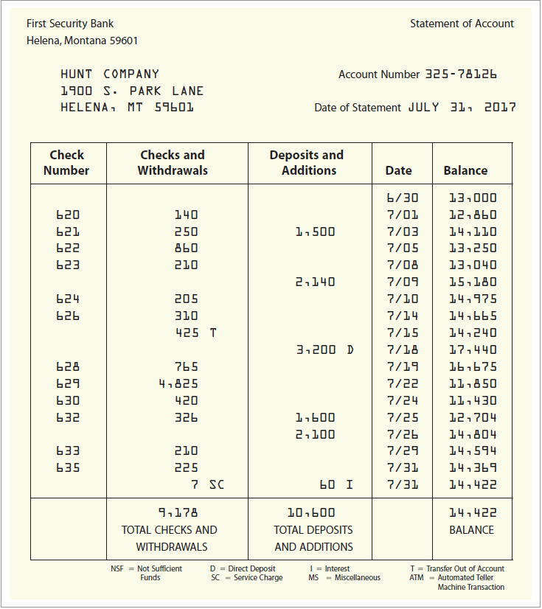
Bank Statement
LO6
Exhibit 5.6

Slide 45
Bank Statement
LO6
Timing Differences
Outstanding checks
Deposits in transit
Banking Entries
Service charges
NSF checks
Direct deposits
Interest paid
Accounting Errors
Journal entries need to be made to record these entries on the company’s books.

Slide 46
Bank Statement
LO6
NSF (Not Sufficient Funds)
Cancellation of a prior deposit that could not be collected because of insufficient funds in the check writer’s account.
Deposits in Transit
Deposits that have not been processed by the bank as of the bank statement date.
Outstanding Checks
Checks that have been written and deducted from a company’s cash account but have not cleared or been deducted by the bank as of the bank statement date.

Slide 47
Bank Reconciliation
LO6
Beginning Bank balance
+ Deposits in transit
– Outstanding checks
+/– Bank errors
Adjusted Bank Balance
Beginning Book balance
+ Interest paid
+ Direct deposits
– Service charges
– NSF checks
– Bank transfer
+/– Accounting errors
Adjusted Book Balance
Account is reconciled when both the adjusted balances are equal.

Slide 48
Bank Reconciliation
LO6
Illustration
Hunt Company’s bank statement indicates an ending balance of $14,422 for the month of July. Hunt’s accountant notes the following:
A deposit of $3,100 on July 31 was not shown on the bank statement. (It was in transit at the end of the month.)
Checks No. 625 for $326, No. 631 for $426, and No. 634 for $185 are outstanding. Check No. 627 was voided at the time it was written.
→ Deposit in transit
→ Outstanding checks

Slide 49
Bank Reconciliation
LO6
Illustration
The bank’s service charge for the month is $7.
A direct deposit of $3,200 was made by Joy Company, a regular customer.
A transfer of $425 was made out of Hunt’s account into the account of Martin Custodial Service for payment owed.
The bank paid interest of $60 on Hunt’s average balance.
→ Service charge
→ Direct deposit
→ Bank transfer
→ Interest paid

Slide 50
Bank Reconciliation
LO6
Illustration
Check No. 630 for Thelma Jones’s wages was recorded in the accounting records as $240 instead of the correct amount, $420.
The cash account in the general ledger shows a balance on July 31 of $13,937.
→ Accounting error

Slide 51
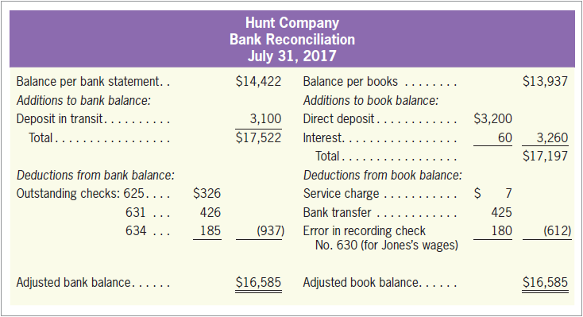
Bank Reconciliation
LO6
Illustration
Exhibit 5.7

Slide 52
Bank Reconciliation
LO6
Illustration
The adjustments required to correct Hunt’s cash account are:
Cash
3,260
Accounts Receivable
3,200
Interest Revenue
60
To record the additions due to the July bank reconciliation (a $3,200 deposit made by Joy Company and $60 interest).
Custodial Expense
425
Miscellaneous Expense
7
Wages Expense
180
Cash
612
To record the deductions due to the July bank reconciliation (service charge, $7; a $180 recording error, check No. 630; bank transfer of $425 to Martin Custodial Service).

Slide 53
Quiz Yourself
LO6
Gold Mountain Company received a bank statement at the end of the month. The statement contained the following:
In comparing the bank statement to its own cash records, Gold Mountain found the following:
Before making any adjustment suggested by the bank statement, the cash balance according to the books is $8,320.
Ending balance .............................................................................. | $9,500
Bank service charge for the month ................................................ | 65
Interest earned and added by the bank to the account balance .... | 45
Deposits made but not yet recorded by the bank .......................... | $2,700
Checks written and mailed but not yet recorded by the bank ........ | 3,900

Slide 54
Quiz Yourself
LO6
What is the correct cash balance as of the end of the month? Verify this amount by reconciling the bank statement with the cash balance on the books.
Solution:
Balance per bank statement ………………………………………….. $ 9,500
Add: Deposits in transit………………………………………………… + 2,700
Deduct: Outstanding checks…………………………………………… - 3,900
Correct balance…………………………………………………………. $ 8,300
Balance per books……………………………………………………… $ 8,320
Add: Interest earned……………………………………………………. + 45
Deduct: Bank service charge….………………………………………. - 65
Correct balance…………………………………………………………. $ 8,300

Slide 55
The Sarbanes-Oxley Act (SOX)*
The Sarbanes-Oxley Act
LO7
Public Company Accounting Oversight Board (PCAOB)
Board of five full-time members established by the Sarbanes-Oxley Act to oversee the accounting and auditing profession.

Slide 56
The Sarbanes-Oxley Act (SOX)*
LO7
Constraints on Auditors
Prohibited from providing several non-audit services to their clients.
Audit partners on engagements be rotated off the audit every five year.
Auditors report to and be retained by the audit committee rather than the CFO or other members of the company’s management.

Slide 57
The Sarbanes-Oxley Act (SOX)*
LO7
Constraints on Management
Prepare a statement to accompany the audit report to certify to the appropriateness of the financial statements and disclosures. Management must also provide an assessment of internal controls in each annual report.
All public companies must develop and enforce an officer code of ethics.
Loans to executive officers and directors are prohibited.
Management must support a much stronger board and audit committee in each public company. The audit committee is a subset of the board of directors.

Slide 58
Regulatory Reactions of Other Countries*
LO7
European Union (EU): The 8th Company Law Directive on Statutory Audit
Japan: The Financial Instruments and Exchange Law (J-SOX)
China: Basic Standard for Enterprise Internal Control (C-SOX)
Taiwan: The corporate governance requirements such as independent directors and audit committee in the Sarbanes-Oxley Act were incorporated into the 2006 amendment to Taiwan’s Securities and Exchange Act.

